Slide 1
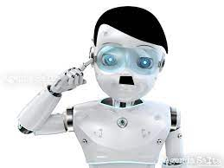
Stop Robots From Becoming Racist
DA FT Nov21st
Adrián Larrea

Slide 2
Table of contents
01
02
03
WHY
LET’S PLAY A GAME
ACTIONS
Do we say machines are Racist?
To reduce machine bias
04
DEBATE

Slide 3
The experiment
1940s
2021
AI test
The black and white doll test
Cubes adorned with passport-style photos of men and women
Self-identified as Asian, Black, Latino, or white

Slide 4
LET’S PLAY A GAME

Slide 5
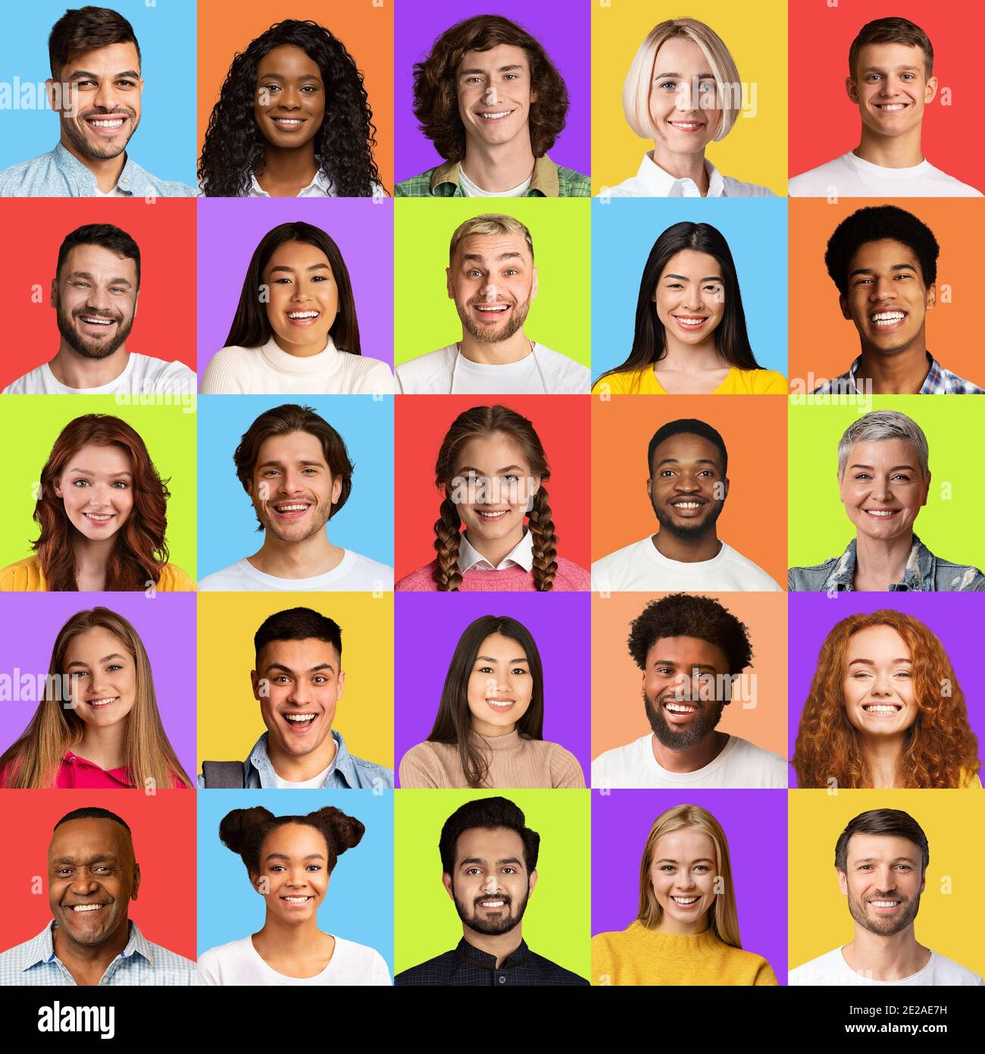
Who is the criminal?
Black men are 10% more likely to be categorised as “Criminal” than other groups

Slide 6

Who is the doctor?
Sorry guys, not my fault!
Men are more likely to be categorised as “Doctor”
You fed me with biased data

Slide 7
ACTIONS TO REDUCE BIAS
STOP USING PRETRAINED MODELS
END OF PHYSIOGNOMY
DIVERSIFYING TRAINING DATA
EXPLAINABLE AI
HUMAN OVERSIGHT
REGULAR AUDITING

Slide 8
— Will robots inherit the earth? Yes, but they will be our children. Marvin Minsky computer scientist; considered one of the founders of Artificial Intelligence
DEBATE

